Slide 1
Progress on DRDC projects
Yutong Zhao
Dec 3rd 2018

Slide 2
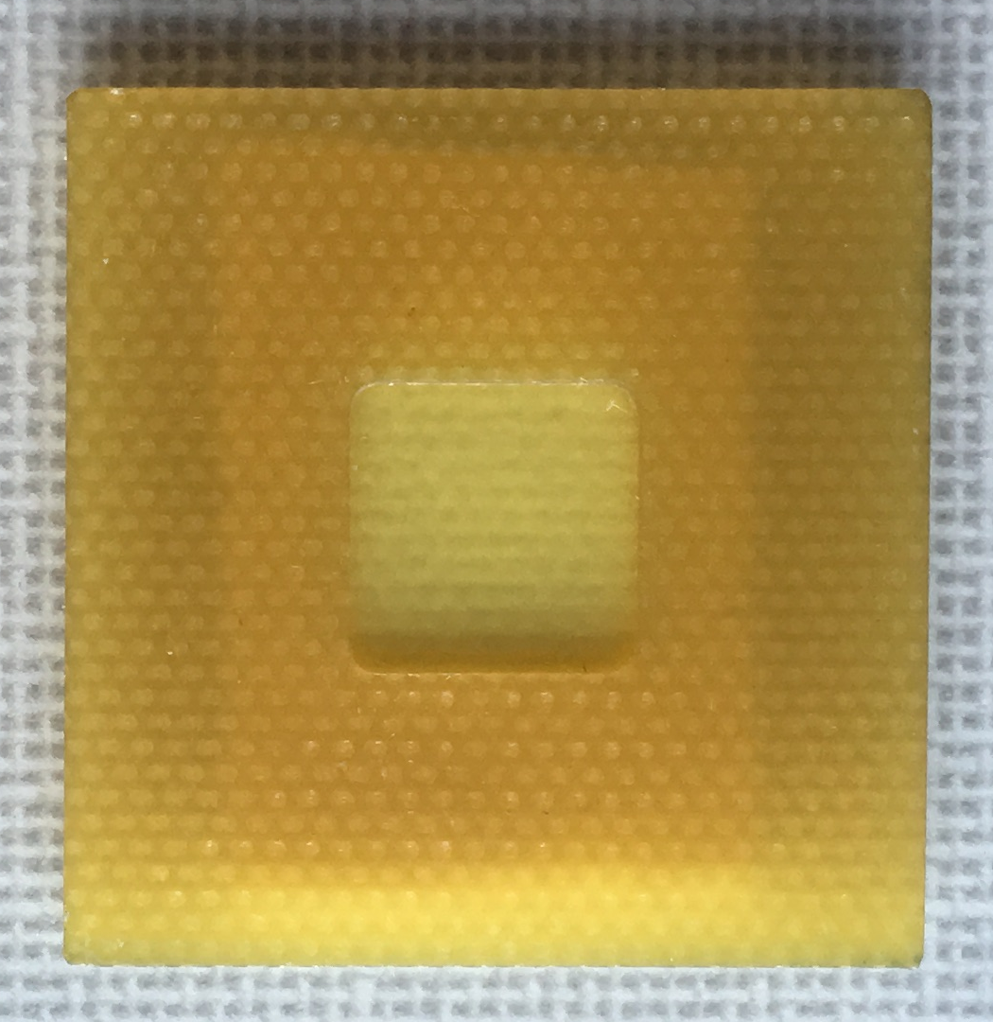
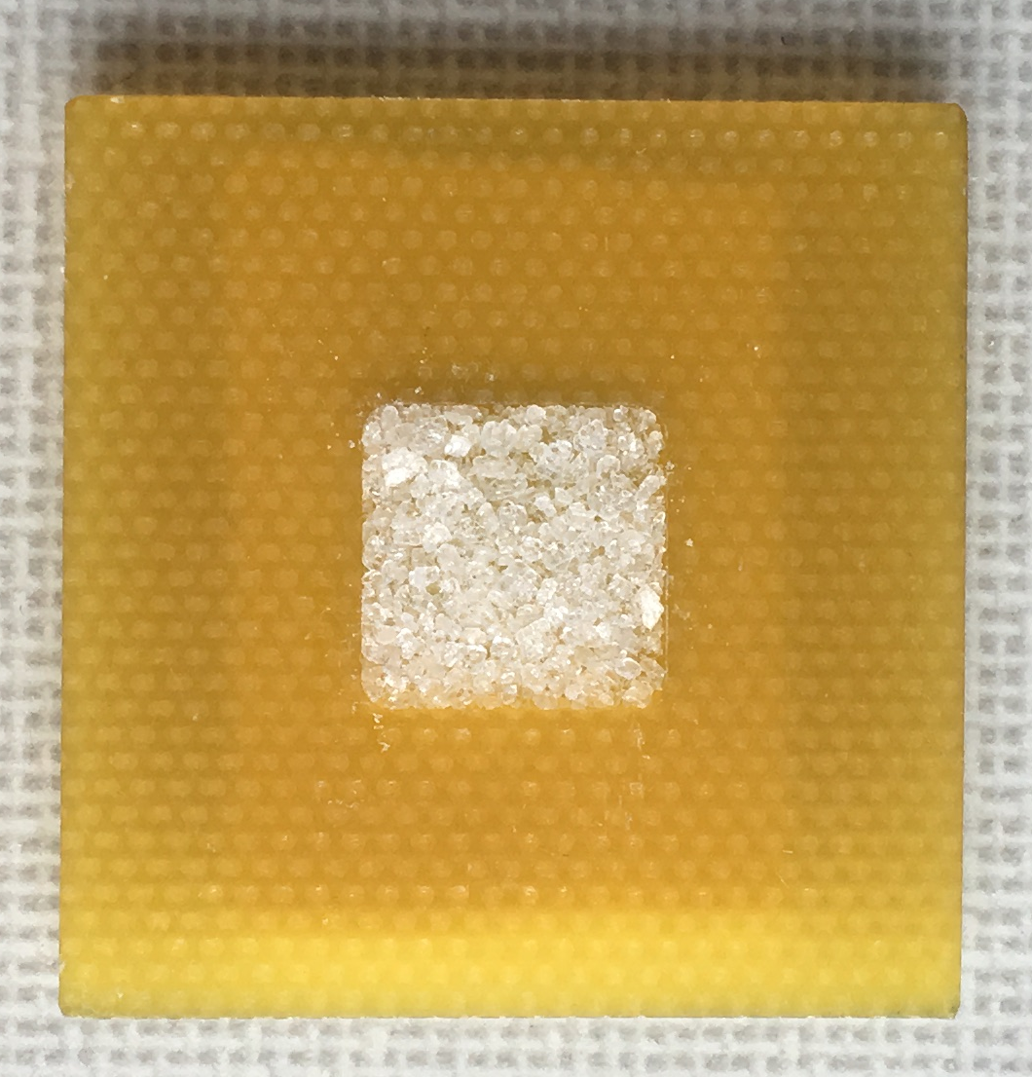
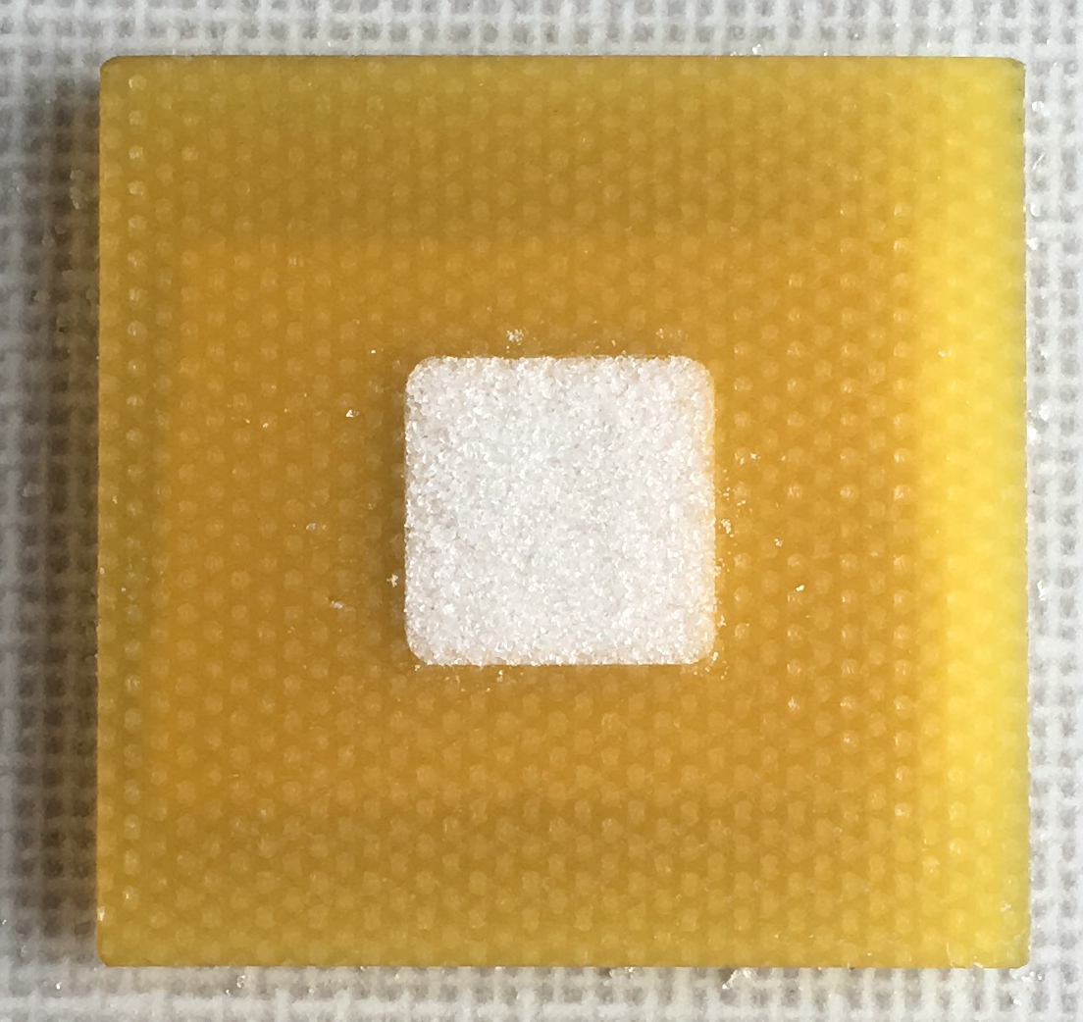
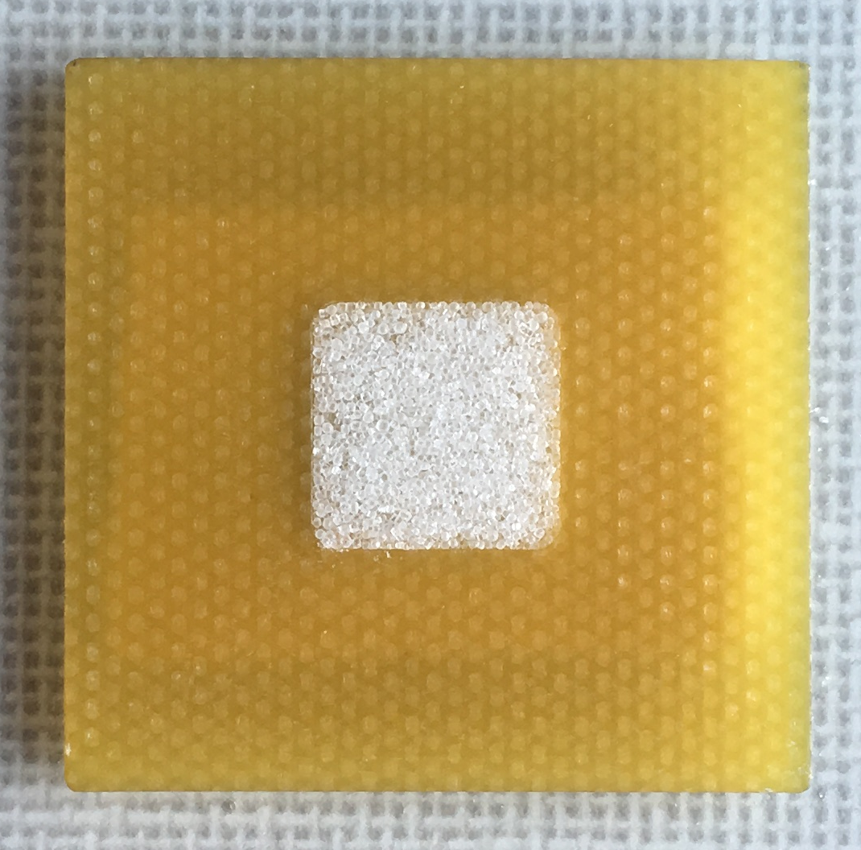
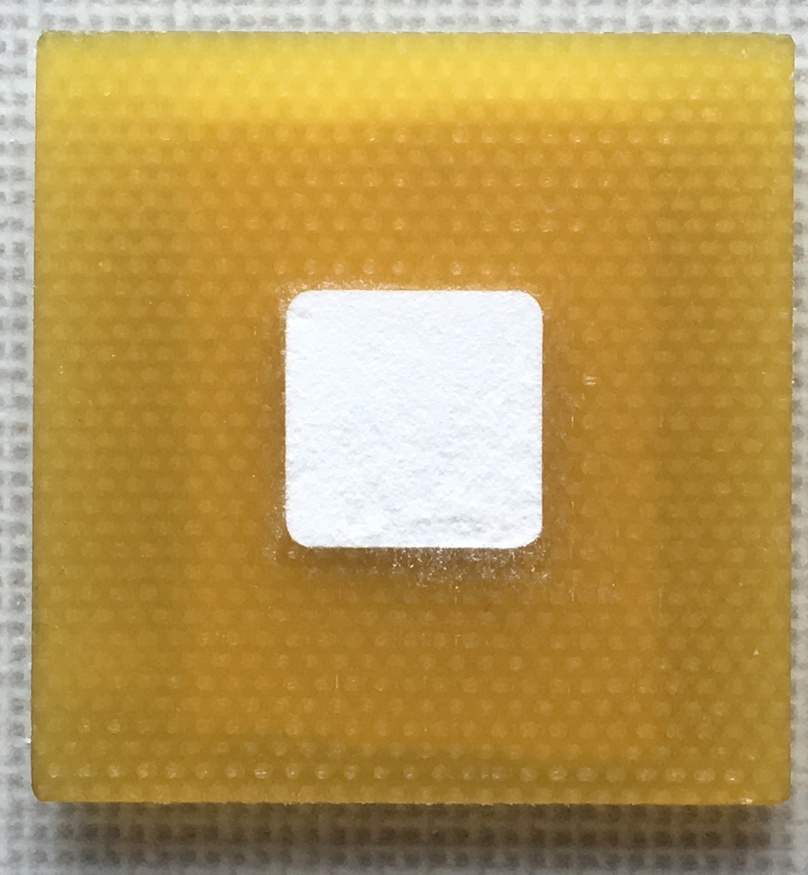
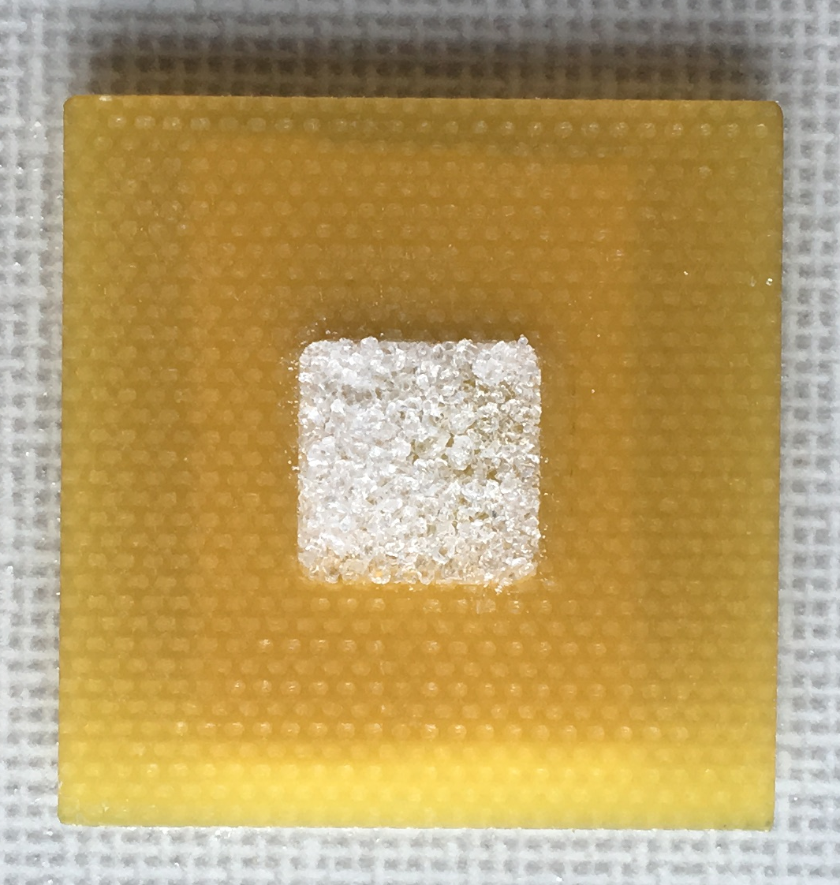
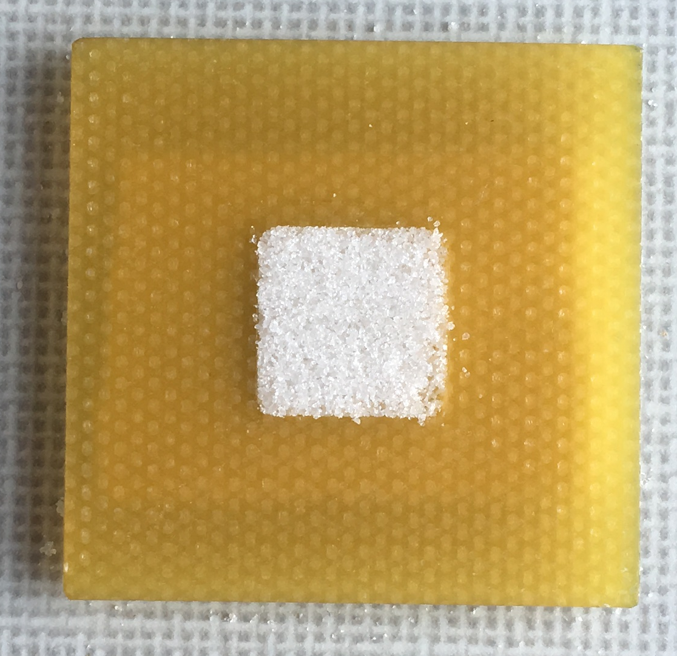
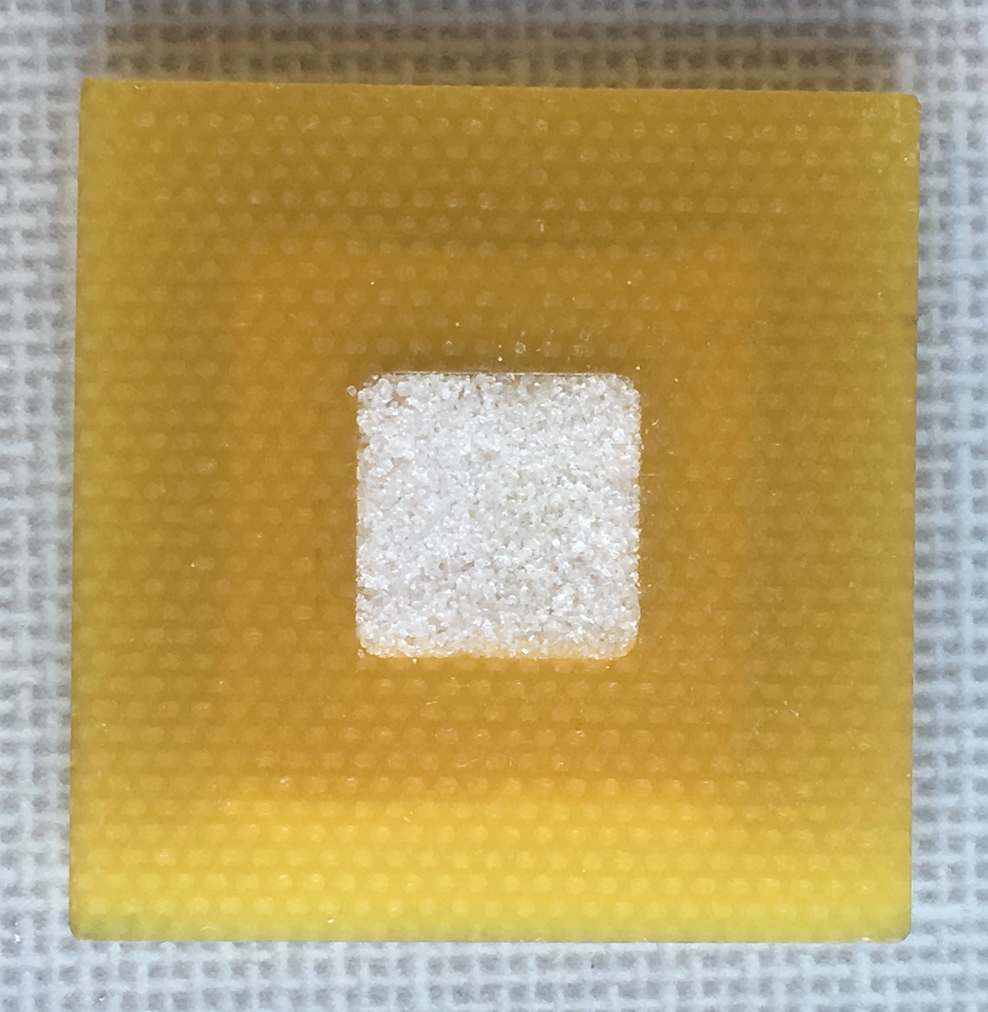
Optical image
Microwave image
Empty holder
KClO₃
KNO₃
NaCl
Empty holder
KClO₃
KNO₃
NaCl
NH₄NO₃& KNO₃
Mixture
NH₄NO₃& KNO₃
Mixture
Icing sugar
NaNO₃
NH₄NO₃
Icing sugar
NaNO₃
NH₄NO₃

Slide 3
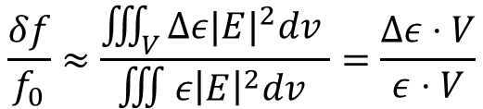
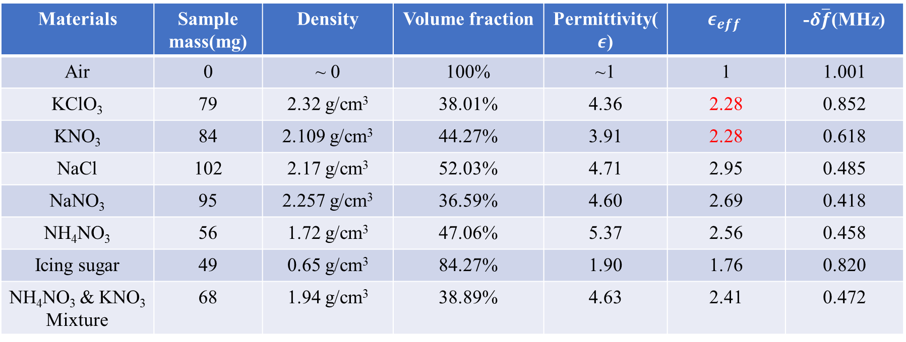
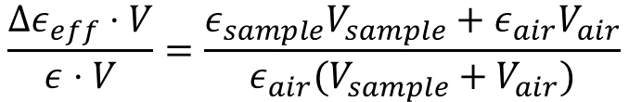
$$\frac{δf}{f_{0}}≈\frac{\iiint_{V}{Δε|E|^{2}dv }}{∭ε{\left|E\right|}^{2}dv }=\frac{Δε⋅V}{ε⋅V}$$
$$\frac{Δε_{eff}⋅V}{ε⋅V}=\frac{ε_{sample}V_{sample}+ε_{air}V_{air}}{ε_{air}(V_{sample}+V_{air})}$$
Materials | Sample mass(mg) | Density | Volume fraction | Permittivity($ε$) | $$ε_{eff}$$ | -$δ\overline{f}$(MHz)
Air | 0 | ~ 0 | 100% | ~1 | 1 | 1.001
KClO₃ | 79 | 2.32 g/cm³ | 38.01% | 4.36 | 2.28 | 0.852
KNO₃ | 84 | 2.109 g/cm³ | 44.27% | 3.91 | 2.28 | 0.618
NaCl | 102 | 2.17 g/cm³ | 52.03% | 4.71 | 2.95 | 0.485
NaNO₃ | 95 | 2.257 g/cm³ | 36.59% | 4.60 | 2.69 | 0.418
NH₄NO₃ | 56 | 1.72 g/cm³ | 47.06% | 5.37 | 2.56 | 0.458
Icing sugar | 49 | 0.65 g/cm³ | 84.27% | 1.90 | 1.76 | 0.820
NH₄NO₃ & KNO₃ Mixture | 68 | 1.94 g/cm³ | 38.89% | 4.63 | 2.41 | 0.472

Slide 4
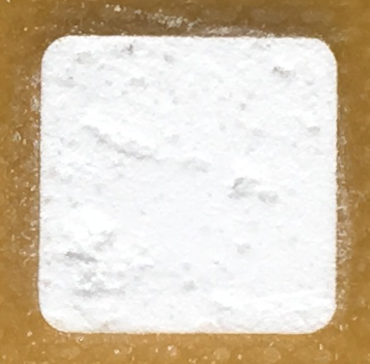
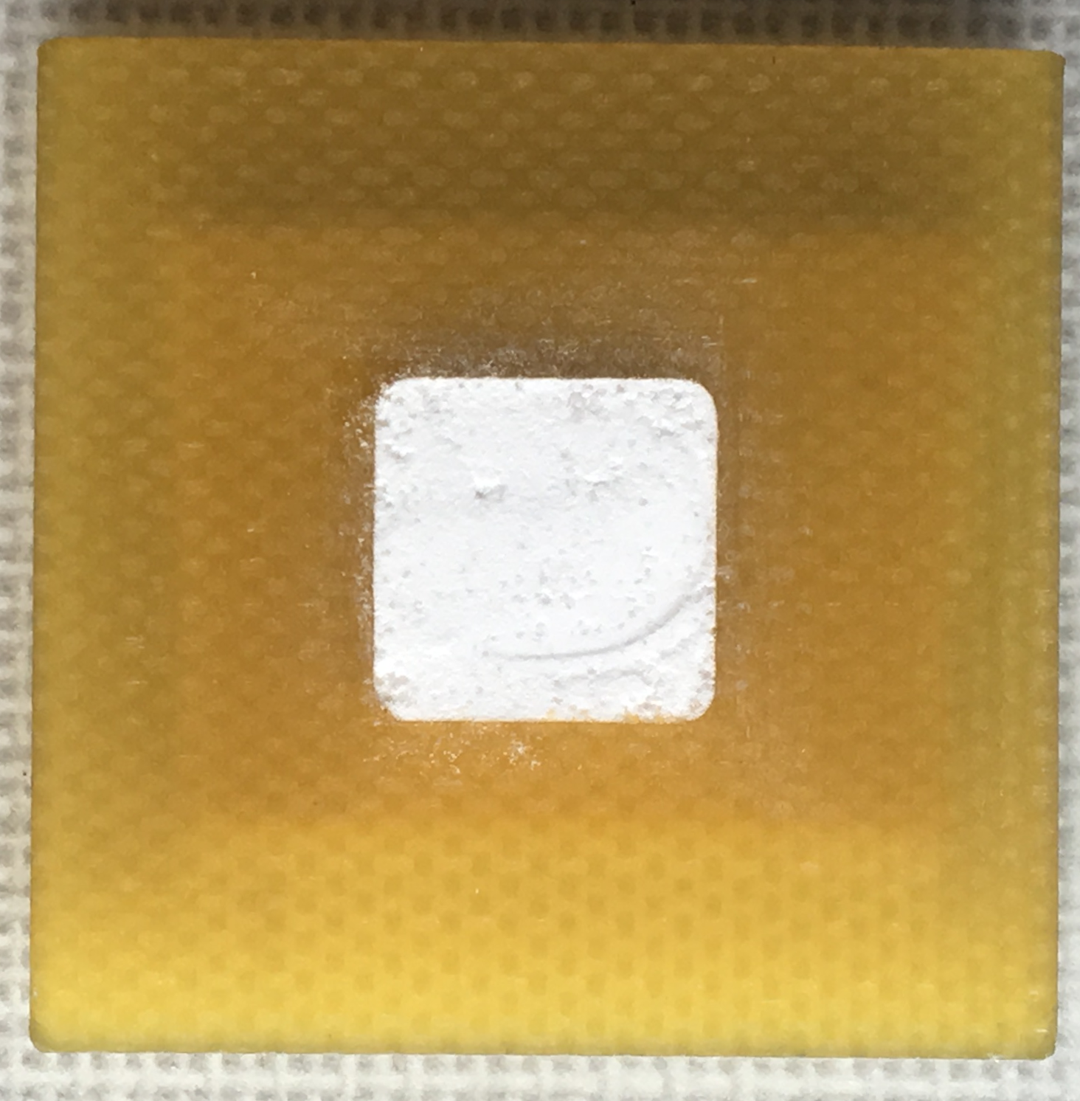
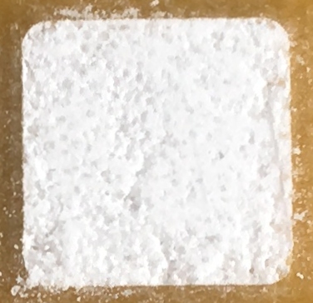
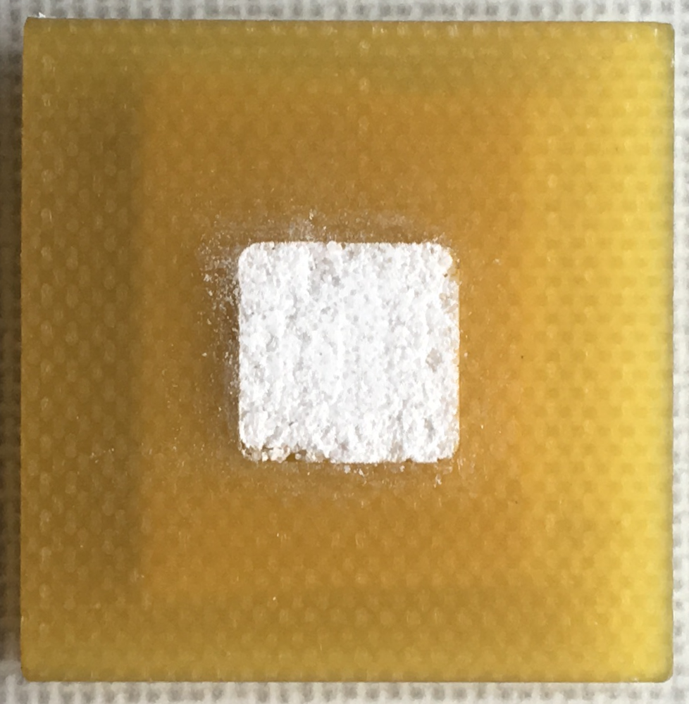
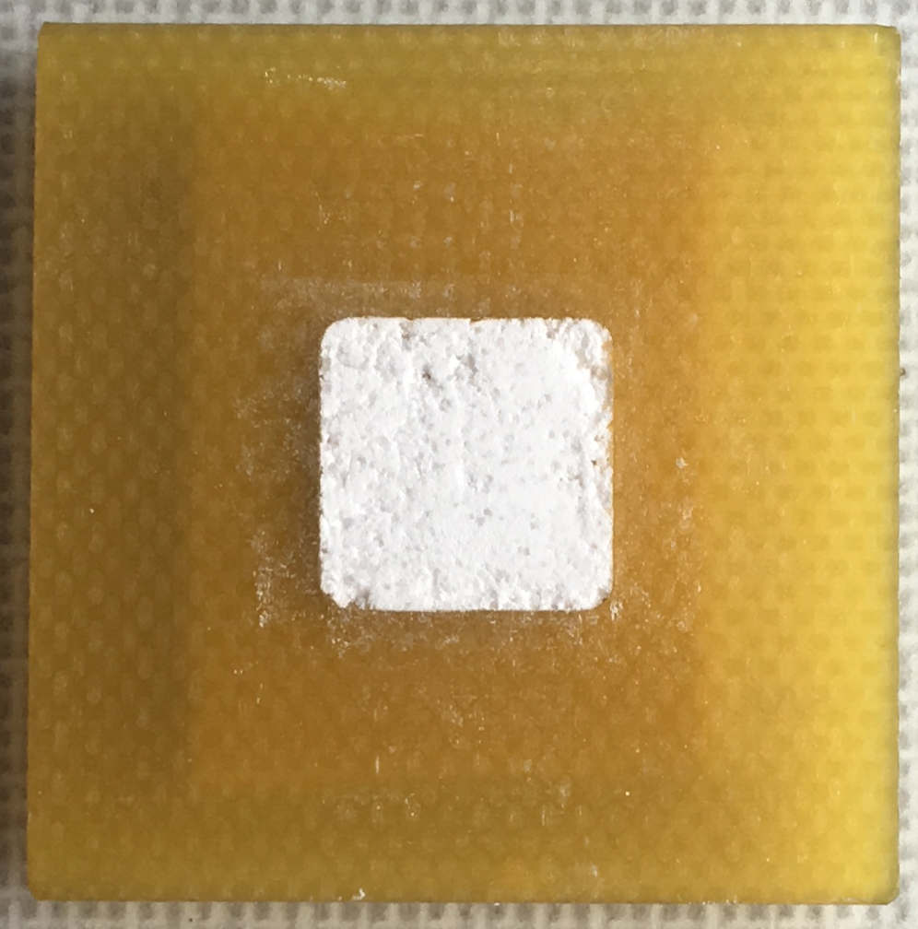
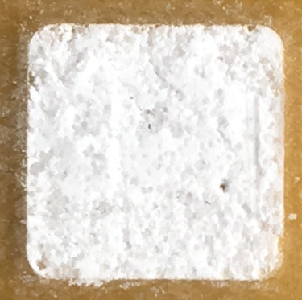
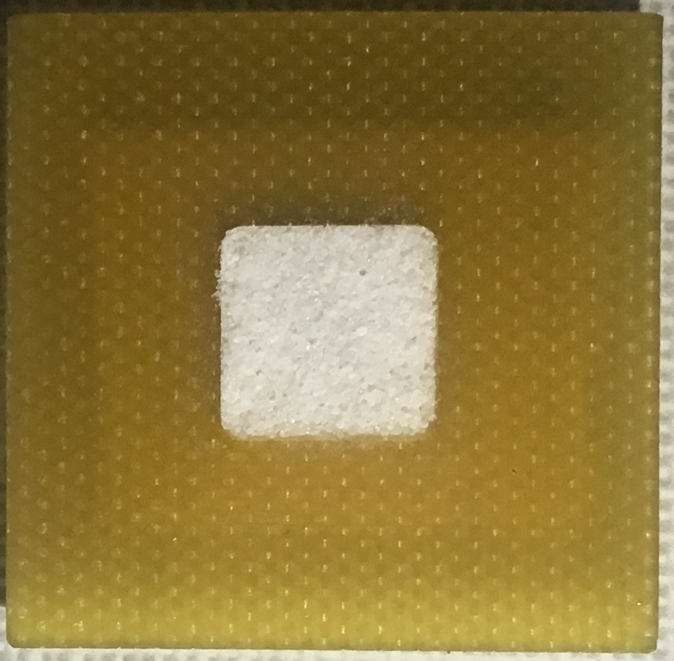
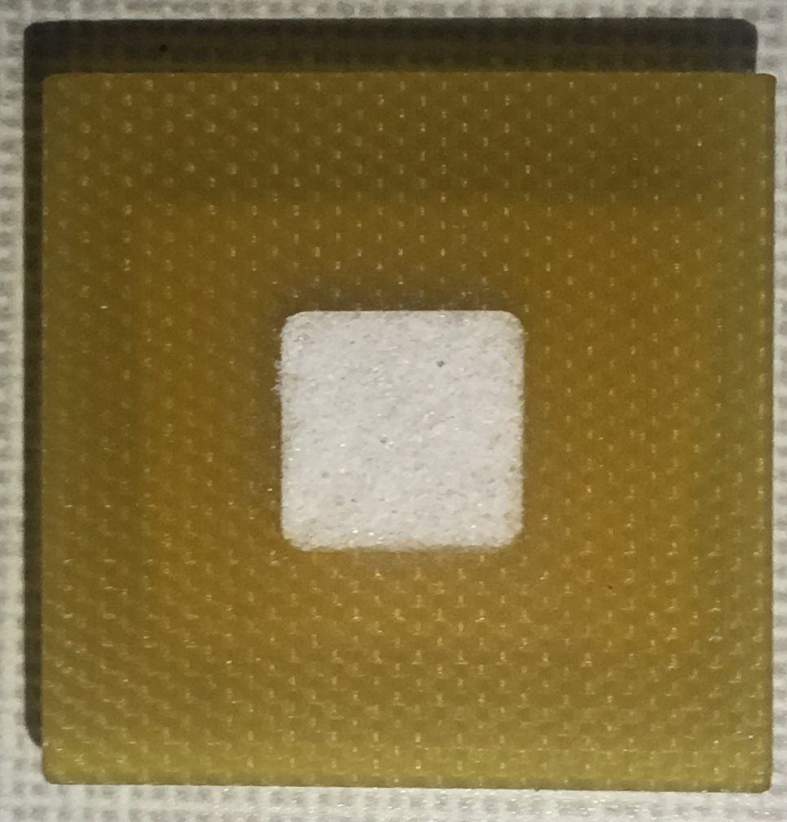
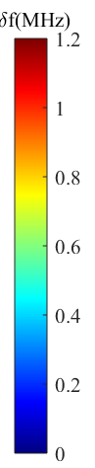
Mixture of icing sugar and NaCl
100%
90%
80%
70%
60%
In volume fraction
Optical image
50%
40%
30%
20%
0%
Microwave image

Slide 5
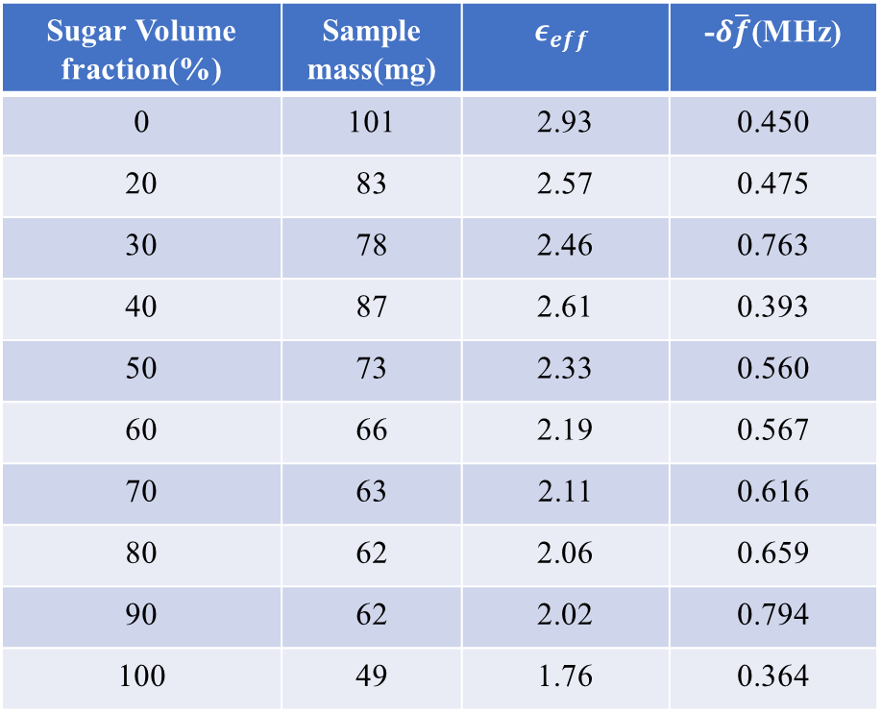
Sugar Volume fraction(%) | Sample mass(mg) | $$ε_{eff}$$ | -$δ\overline{f}$(MHz)
0 | 101 | 2.93 | 0.450
20 | 83 | 2.57 | 0.475
30 | 78 | 2.46 | 0.763
40 | 87 | 2.61 | 0.393
50 | 73 | 2.33 | 0.560
60 | 66 | 2.19 | 0.567
70 | 63 | 2.11 | 0.616
80 | 62 | 2.06 | 0.659
90 | 62 | 2.02 | 0.794
100 | 49 | 1.76 | 0.364

Slide 6
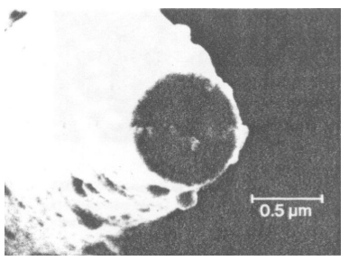
Summary:
The resonant shift of the is approximate a linear relation as effective permittivity.
It is unlikely to give the precise value due to large error bars.
The spatial distribution of chemical powders can be obtained using this method.
Next step:
Prepare more mixtures (two or three) and measure using of scanning technology.
Determine the dielectric constant of chemical solutions using broadband technique.
(non-resonant method).
Compare these results with different methods.
Sensor design:
Penetration depth: ↑
Resolution: ↓
Penetration depth: ↓
Resolution: ↑
Resolution: ~ nm
Only surface properties

Slide 7
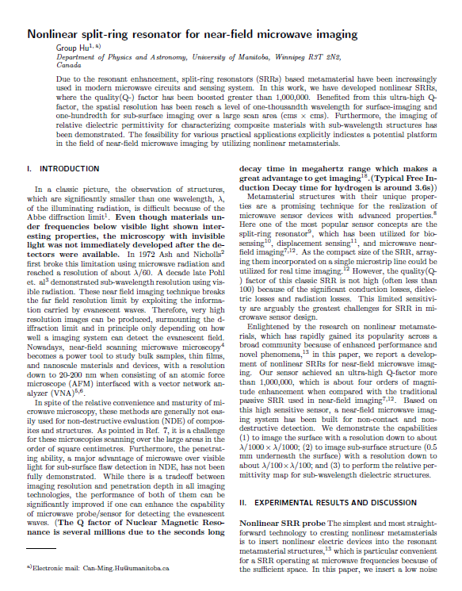
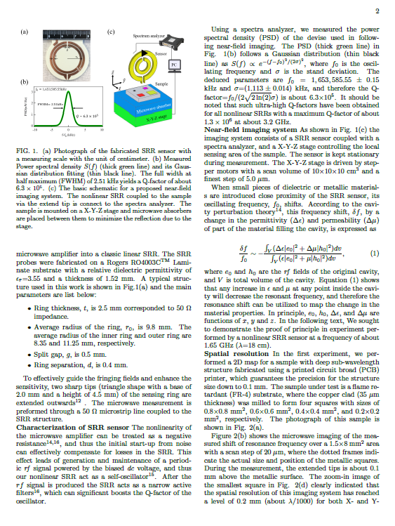
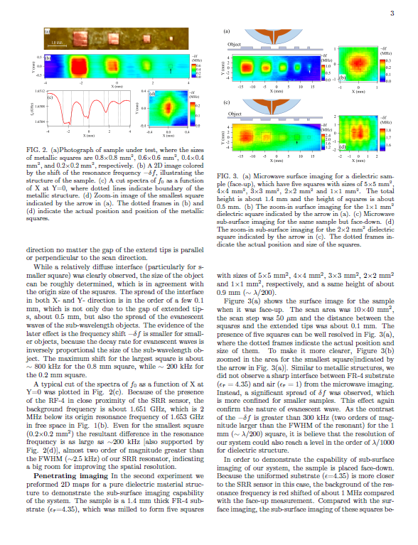
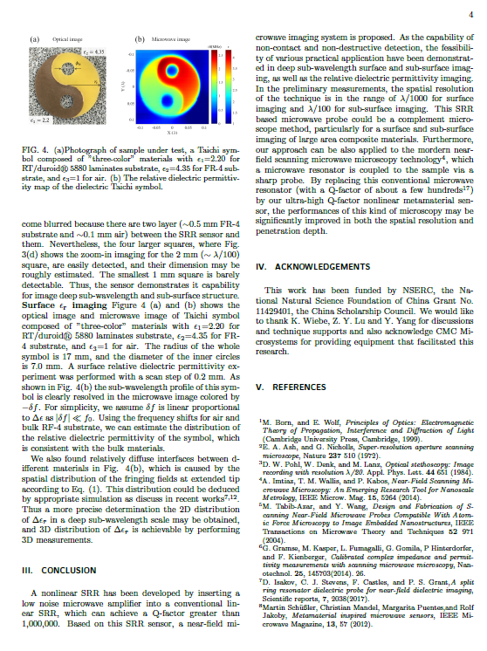
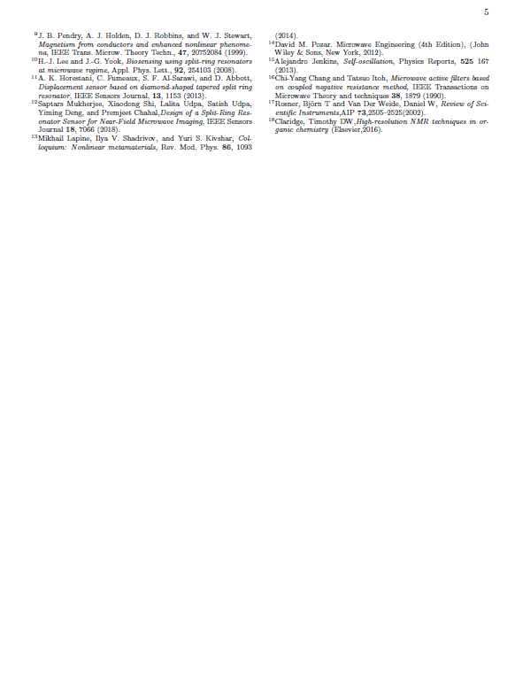
Finished first draft of the paper of dielectric imaging

Slide 8
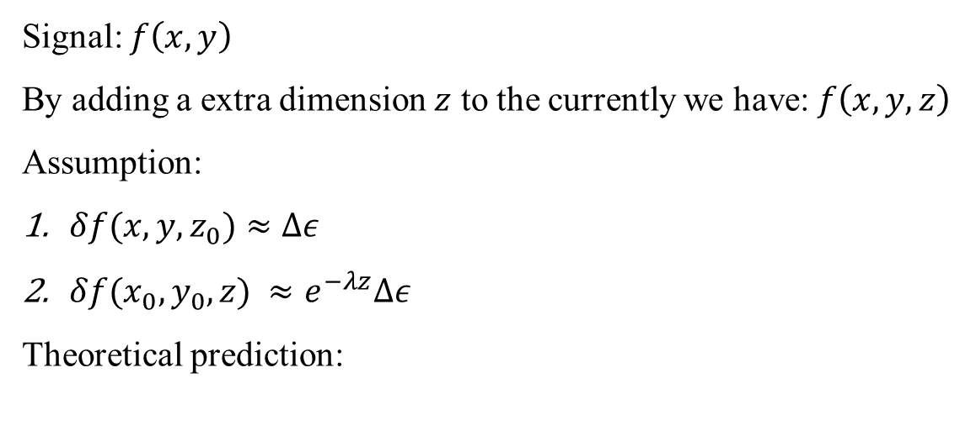
Signal: $f\left(x,y\right)$
By adding a extra dimension $z$ to the currently we have: $f\left(x,y,z\right)$
Assumption:
$δf(x,y,z_{0})≈Δε$
$δf(x_{0},y_{0},z) ≈e^{−λz}Δε$
Theoretical prediction:
Discussion:
The active SSR is able to detect dielectric constant of different materials.
As for chemicals, it is influenced by the size of the chemical granules and surface inhomogeneity.
It is very difficult to distinguish explosive chemicals and normal materials by using this method.
Plot in a.u.
Ok result/ large error
Good result/ small error
Surface
Surface

